Slide 2
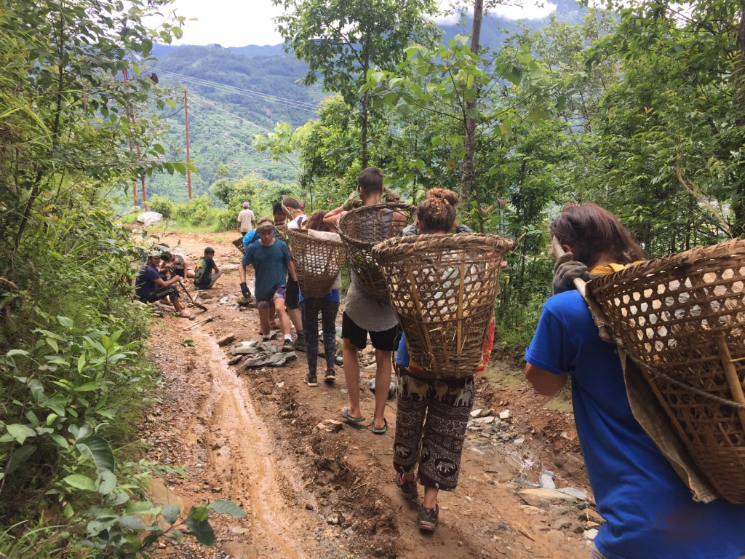
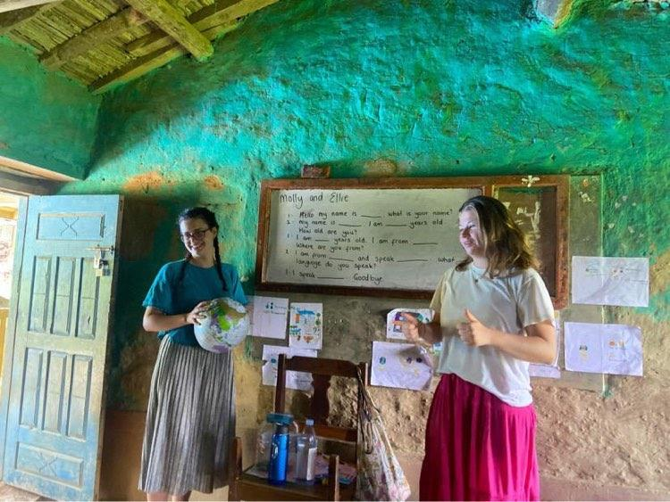
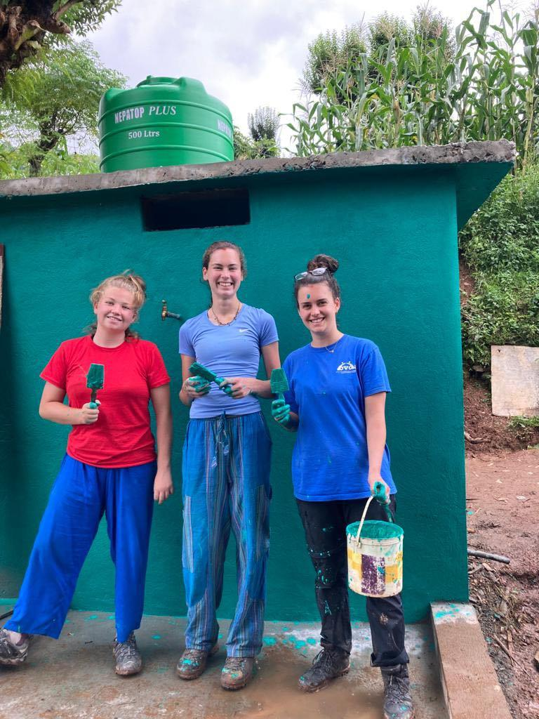
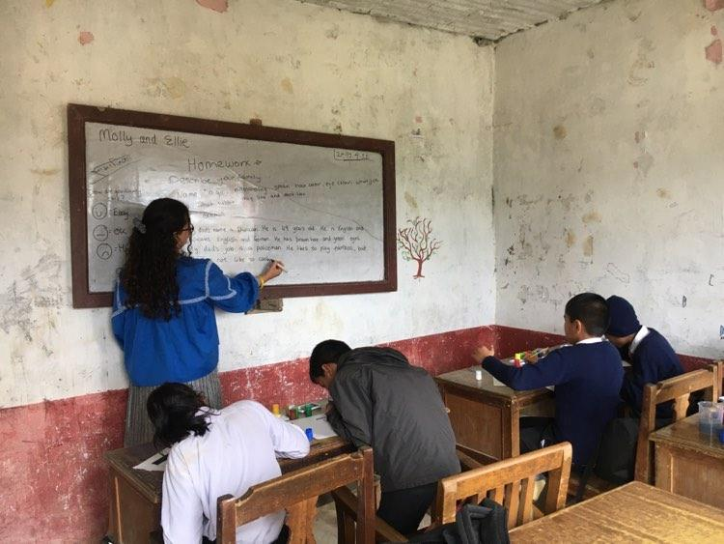
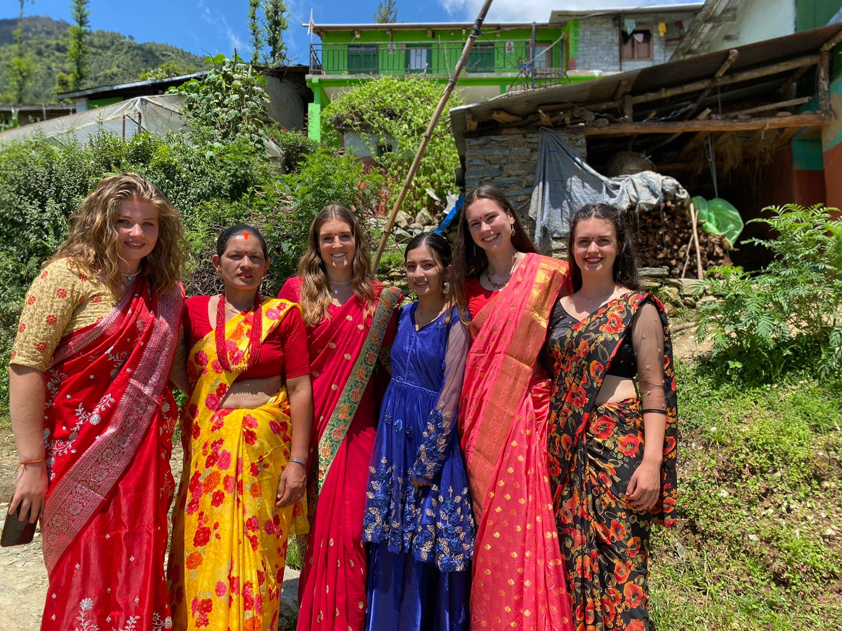
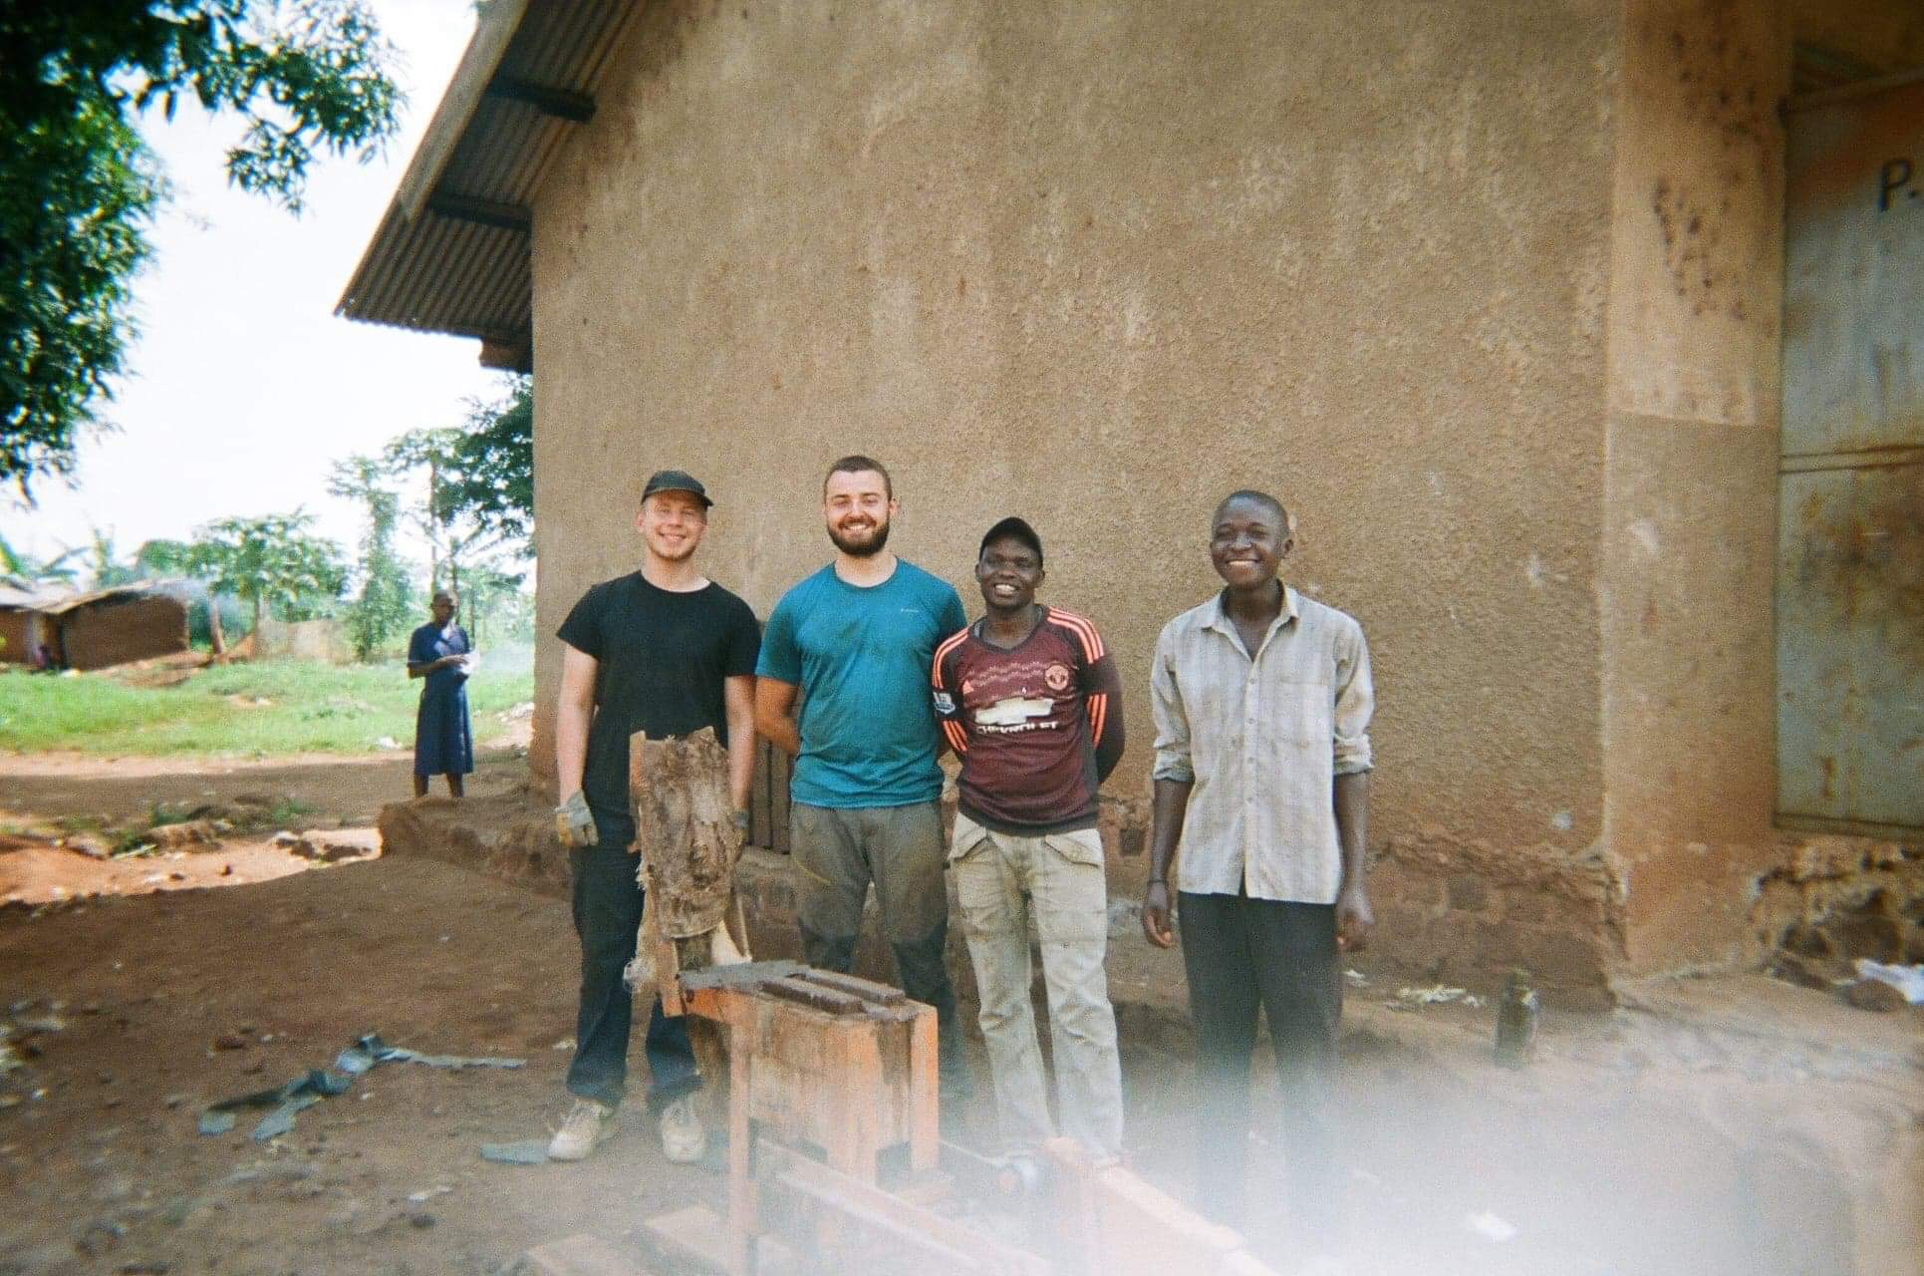

Slide 3
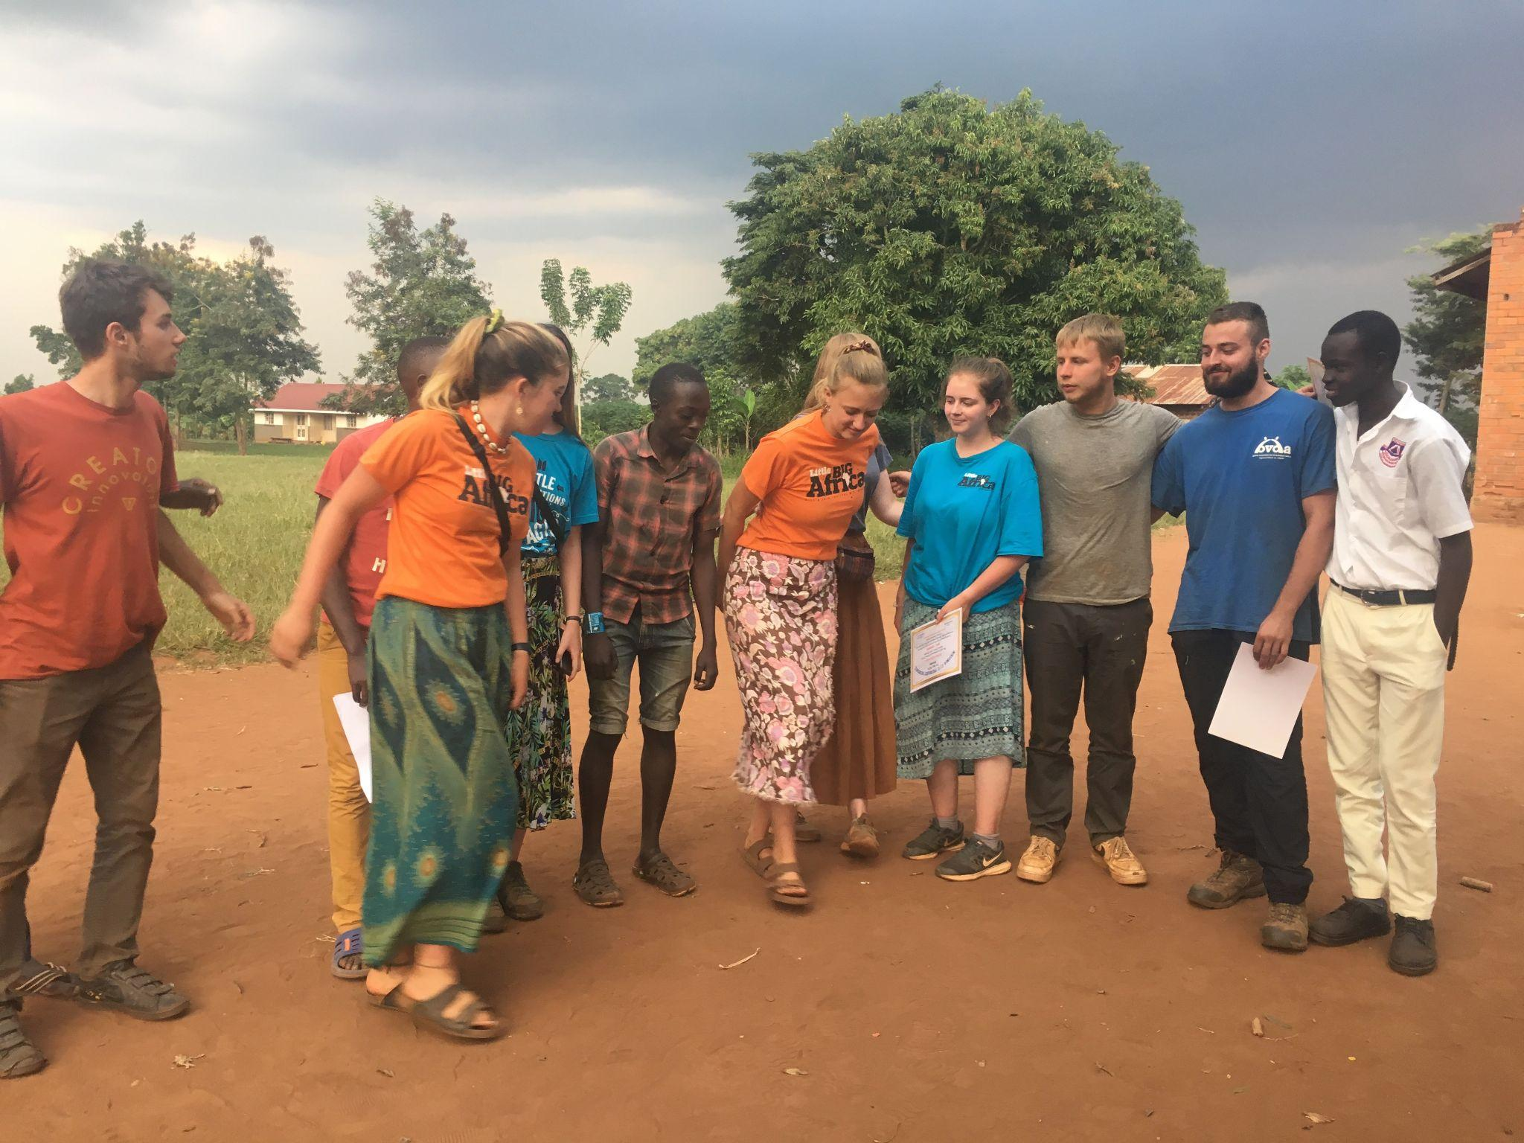
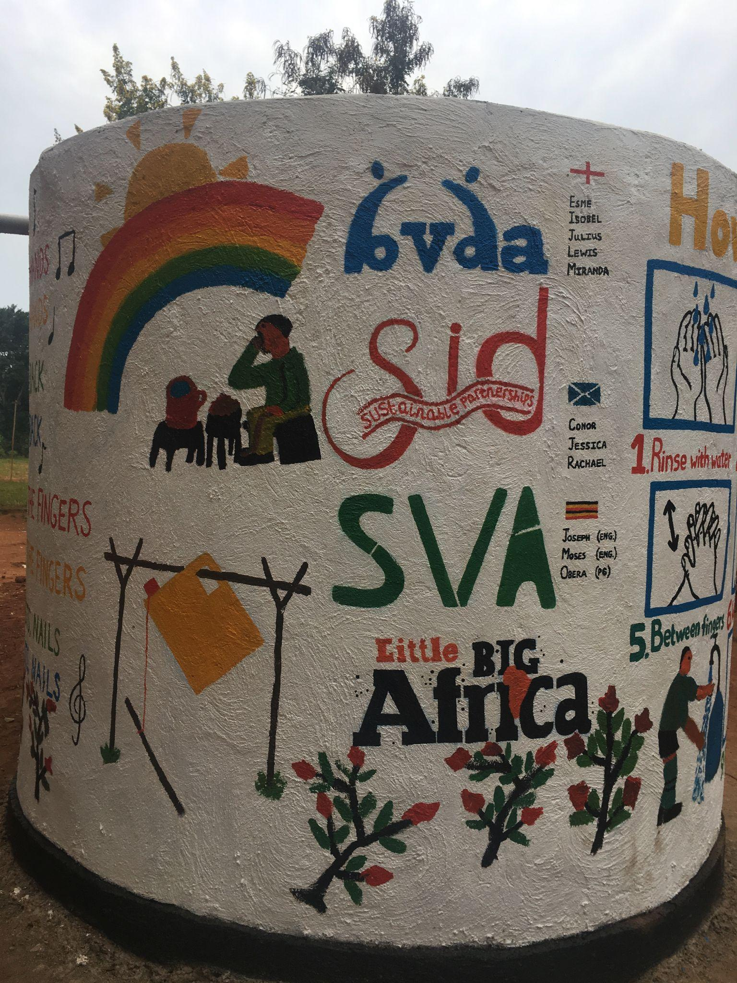
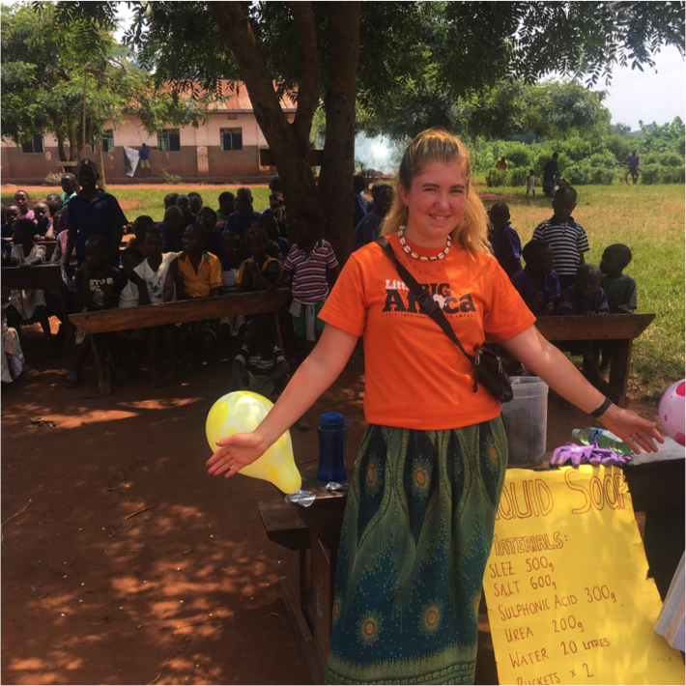
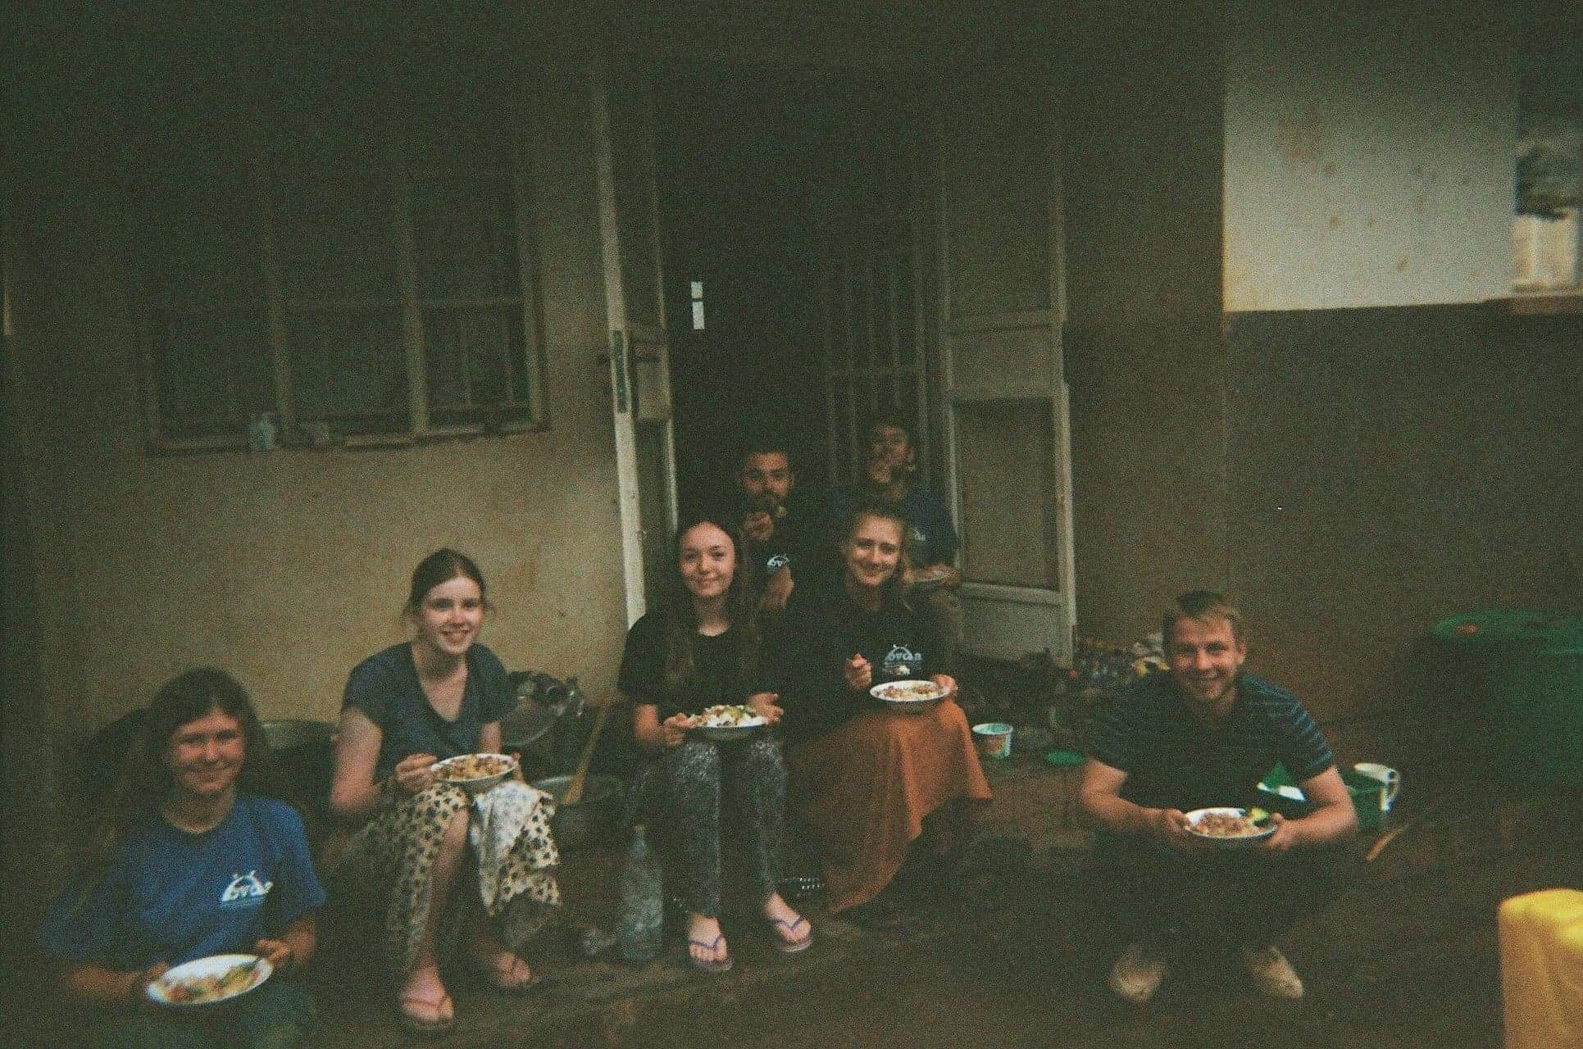

Slide 4
01
Information
Talk

Slide 5
02
About Us
Led by UoB students
Support our partners
Sustainable development
A registered charity led by UoB students and oversaw by alumni.
Work with our global NGO partners to deliver responsible volunteering.
Our projects focus on international development and sustainability.

Slide 6
Our Aims
03
Work in partnership with communities and grassroot organisations to deliver sustainable development, including education, capacity building, water, sanitation, and health initiatives
Provide a platform for a meaningful discussion around international development
Give students the opportunity to develop skills for the future through international volunteering, empowering them to become active citizens

Slide 7
04
The Committee
We are recruiting!
President
Victoria
Secretary
Project Parent
Kertu
Fundraising Officer
Publicity Officer
Darci
Social and Inclusivity Officer

Slide 8
The Trustees
05
Ben
Celestine
Liam
Caitlin
Vaihari
Finance
Publicity
Equality
Project
Legal
M&E

Slide 9
Journey as a BVDA Volunteer
06
Application
Fundraising
Consists of a short written application, followed by a chat with committee members.
Setting your goal and organising fundraising events/challenges. Get involved in group fundraising!
Training
Travel + Volunteer
Workshops, led by committee, trustees and external speakers, on topics important to your project.
Remain in contact with the committee and partner NGO throughout project. Enjoy the experience!

Slide 10
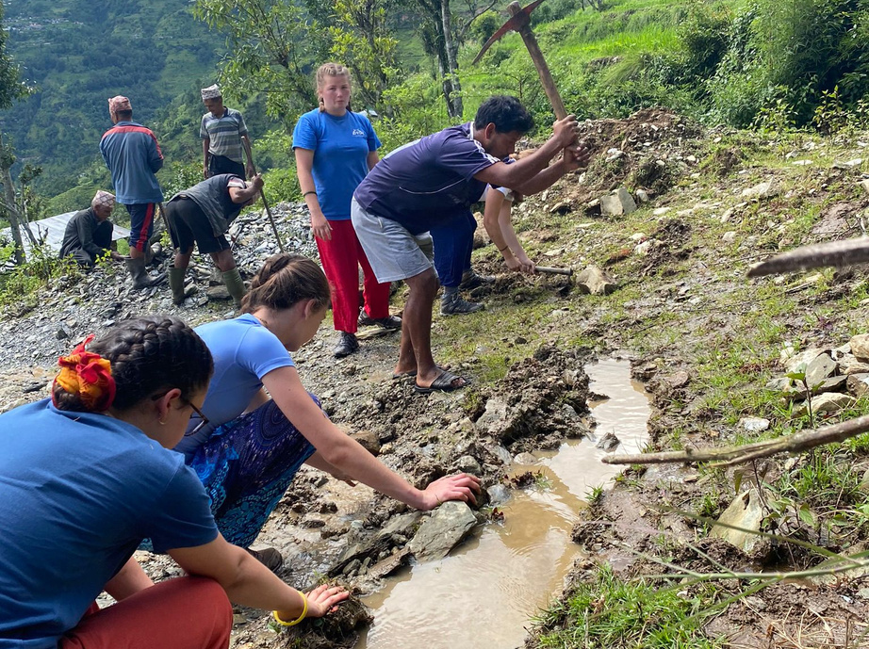
Project Outline
07
SUMMER 2024
In partnership with PSD Nepal
Group of 4-6 volunteers
Living with a host family
Duration of 6-8 weeks
Days off to explore
Language and cultural training
Everlasting friendships
Construction/Educational based
Fundraise £700-900

Slide 11
Project Finance
08
Project costs
Additional costs
Project costs are provided to BVDA by our partner NGO and includes volunteers’ internal travel, accommodation, food, training and material costs.
More volunteers = Cheaper cost per person
BVDA helps you fundraise the project costs!
Additional costs are those that each volunteer needs to personally finance. This includes flights (£900-1100 return), vaccinations (£150), travel insurance (£100), DBS check (£18) and any spending money (£300).
Previous volunteers have estimated they spent £1500-1700 for their additional costs.

Slide 12
The Volunteers
09
UoB student
Adventurous, compassionate, organised
Passionate about international development
No previous volunteering experience required
Interested in becoming committee next year

Slide 13
Volunteer with us!
Fill out our Volunteer Application
Deadline: Sun 21st Jan
Chat with committee
Training begins soon after

Slide 14
Join our committee!
Fill out our Committee Application
Deadline: Fri 1st Dec

Slide 15
Contact Us
bdva_bristol
/bristolvols
bdva.org.uk
commitee@bdva.org.uk

